Slide 1
RUNGTA COLLEGE OF DENTAL SCIENCES AND RESEARCH
Endodontic instruments
DEPARTMENT OF CONSERVATIVE DENTISTRY AND ENDODONTICS

Slide 2
Specific learning Objectives
At the end of this presentation the learner is expected to know ;
Core areas* | Domain ** | Category #
History | Cognitive | Nice to know
Kerr engine drills | Cognitive | Nice to know
GG burs | Cognitive | Must know

Slide 3
Content
Standardization of Instruments given by Ingle and Levine
Classification of Endodontic Instruments
Group I Hand-operated Instruments
Files
Group II Low Speed Instruments with Latch-Type Design
Group III Engine-Driven Instruments
Generations of NiTi Rotary Files
First Generation NiTi Rotary Files
Second Generation
Third Generation Files
Fourth Generation Reciprocating Instruments
Fifth Generation Instruments
Scout Race Files
Group IV Sonics and Ultrasonics in Endodontics
Sonic Handpiece
Instrument Deformation and Breakage
Instruments Used for Filling Root Canals

Slide 4
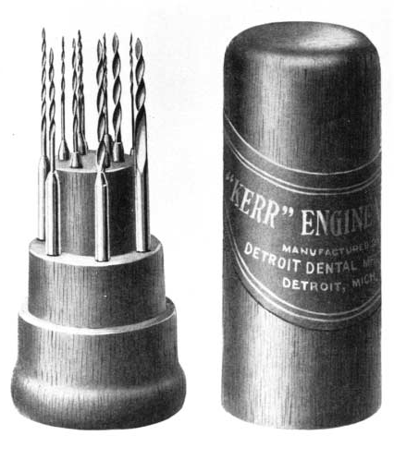
KERR ENGINE DRILLS (1912)

Slide 5
GATES-GLIDDEN BURS :
It has a bud shaped cutting point mounted on a fine shaft attached to latch type shank
The bud has a fine blunt tip which acts as a path finder within the root canal
Fracture occur at the junction of the shaft with the shank facilitating its removal
Made in stainless steel or nickel titanium and are available in various lengths
and bur diameter ranges from 0.5-1.5mm

Slide 6
There are 6 sizes each bur is marked on the latch attachment portion of the instrument with an indented strip to indicate the size.
Gates –Glidden drill | Instrument size in mm | Equivalent K-file size
#1 | 0.50 | 50
#2 | 0.70 | 70
#3 | 0.90 | 90
#4 | 1.10 | 110
#5 | 1.30 | 130
#6 | 1.50 | 150

Slide 7
Hand Stainless Steel Files v/s Hand NiTi Instruments
Cunningham – NiTi files were more effective in maintaining the original canal path of curved root canals when apical preparation was enlarged beyond #30.
2. Walker – NiTi files remained significantly more centered &
demonstrated less apical transportation than stainless steel files at size 25.
When preparation continued to size 40 with step back,
No Significant Difference in transportation apically or coronally
3. Zmener – NiTi files prepared more centered and tapered preparations than conventional K-files.

Slide 8
Hand Stainless Steel Files v/s Rotary NiTi Instruments
Baumgartner – Lightspeed and Profile were faster and stayed centered better than stainless steel hand files.
2. Toda – Rotary files were faster and decreased undesirable outcomes such as zip, elbow or ledge.
3. Messer – Rotary instrumentation may produce better canal shape versus stainless steel by reducing procedural errors.

Slide 9
ROTARY INSTRUMENTS
STANDARDIZATION
Before 1958, endodontic instruments were manufactured according to the whim of manufacturers with no definite specifications.
In 1958, Ingle and Levine first proposed a standardization criteria.

Slide 10
Rotary instruments
Taper
Flute design
Rake angle
Helical flute angle
Core diameter /flute depth
Tip Geometry
Radial lands

Slide 11
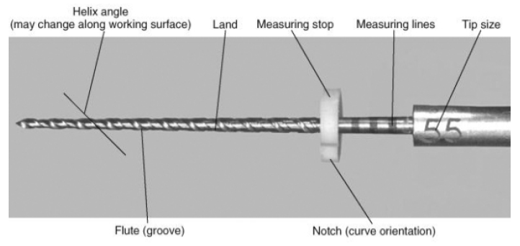
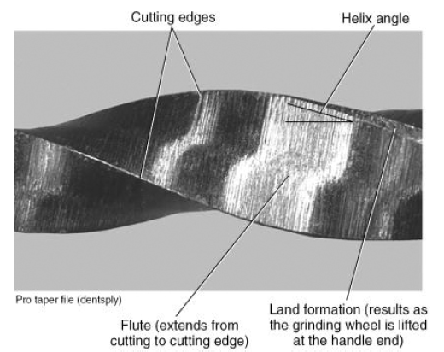
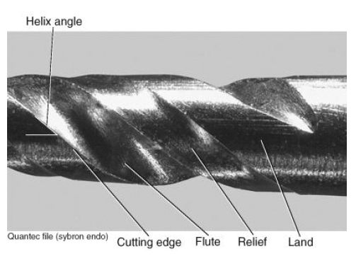

Slide 12
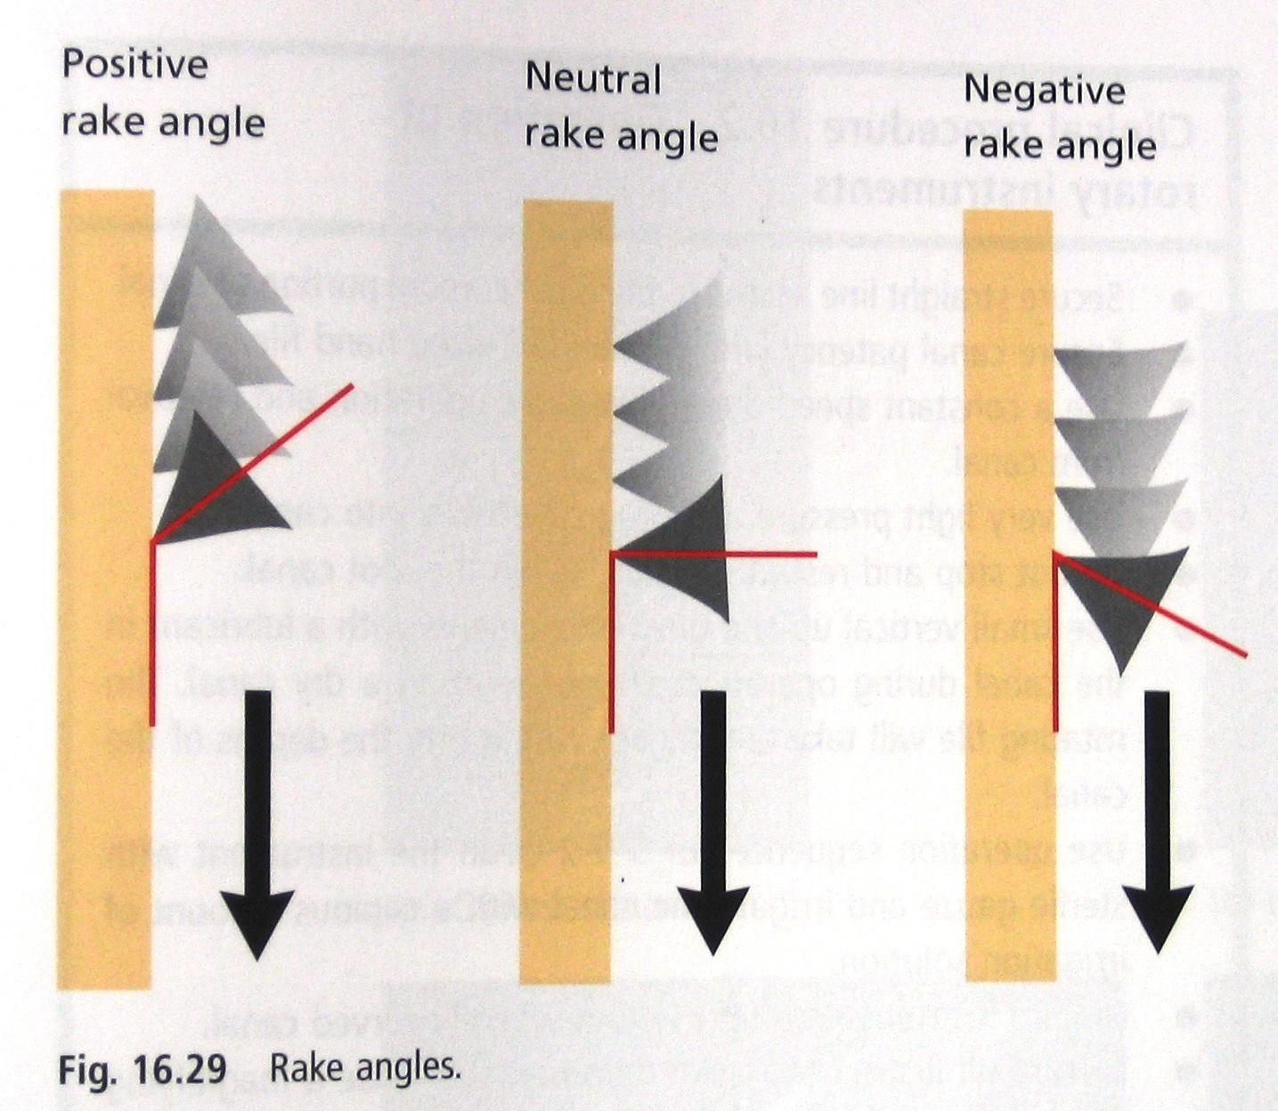

Slide 13
Dr. Johnson classified all rotary instruments as having:
Active | Semiactive | Passive
K-Type Configuration PowR, Flexmaster, RaCe HERO, ProTaper. | Quantec, ProTaper Universal | U-File, LightSpeed, Rotary GT, ProFile.
Actively pulled in canal when rotated & Cuts Dentin | Slowly pulled in canal & Cuts Dentin

Slide 14
Three design groups need to be analyzed separately:
Group I LightSpeed;
Group II Rotary instruments with #.04 and #.06 tapers, which includes the ProFile and many other models
Group III Rotary instruments with specific design changes, such as the ProTaper and RaCe

Slide 15
Post-instrumentation shape of curved canals was superior when prepared withflexible stainless steel instruments than with conventional files
(Briseno & Sonnabend 1991, Al-Omari et al . 1992).
Instruments are less prone to fracture when rotational speed is decreased
Deitz DB et al: Effect of rotational speed on breakage of NiTi rotary files
J Endod 26:68, 2000.
Gabel WP et al: Effect of rotational speed on NiTi file distortion
J Endod 25:752, 2000.
Type of handpiece is not important as the force applied & operational speed used

Slide 16
The efficacy of ultrasonic irrigation to remove artificially placed dentine debris from human root canals prepared using instruments of varying taper
IEJ, 38, 764–768, 2005
L. W. M. van der Sluis, M-K. Wu & P. R. Wesselink

Slide 17
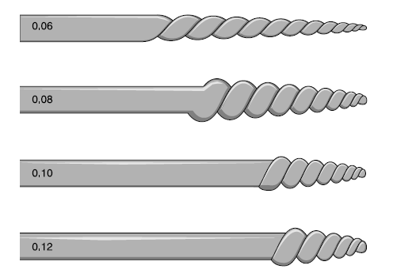
INCREASED TAPER =INCREASED EFFICIENCY
2%
4%
6%
8%
10%
12%

Slide 18
Crown-Down Tip Design and Shaping Teresa Ponce de Leon Del Bello,, Nancy Wang,, and James B. Roane, Journal Of Endodontics Vol. 29, NO. 8, August 2003
Some observations from the study follow:
1. Tip design has a strong influence on the final canal shape.
Modified biconical tips(Flex-R)lead to better instrumentation results.
Instruments with biconical-shaped tips are an improvement over instruments with pyramidal or conical “conventional” tips.
2. The incremental shaping of the crown-down technique depends on the performance of an instrument’s tip and requires selection of instruments that provide exceptional guidance.
Instruments with sharp transition angles, and particularly, instruments with pyramidal shapes are undesirable.
3. Tip design affects the ease with which a canal can be shaped.
Ledges are more frequent with pyramidal-shaped tips.
Transportation is common with conical and pyramidal-shaped tips.
The best shapes resulted from use of a biconical-shaped file tip.

Slide 20
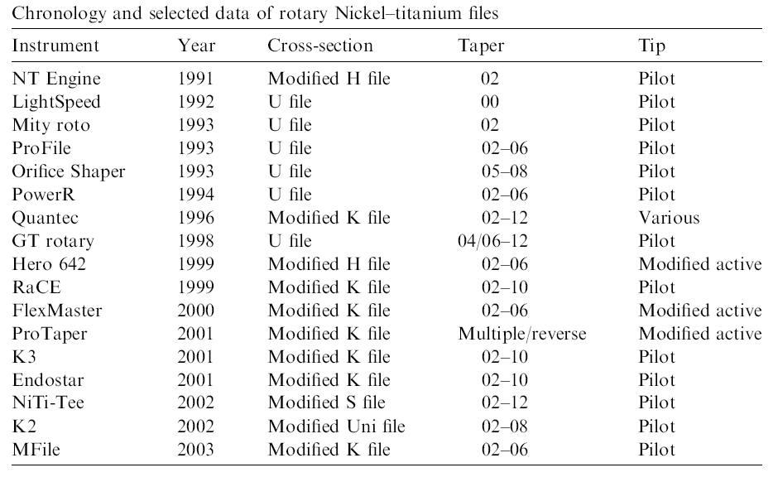

Slide 23
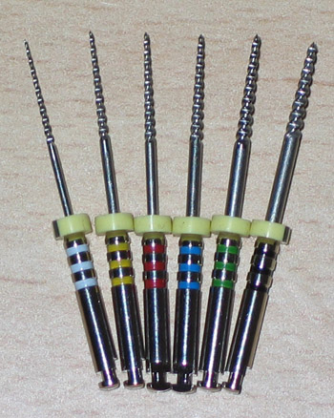
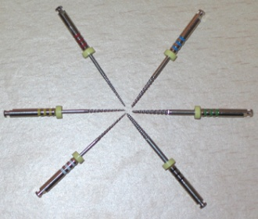
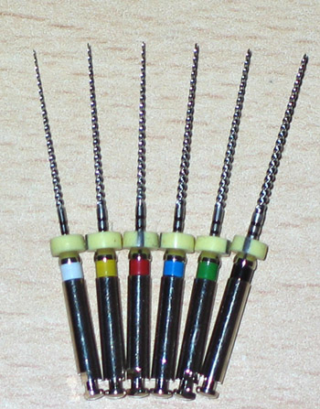
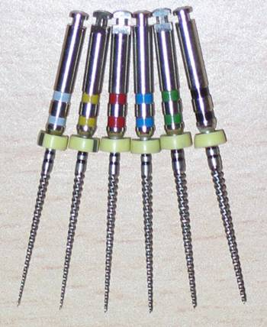
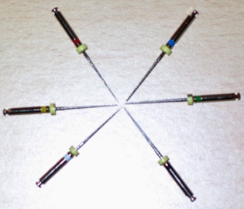
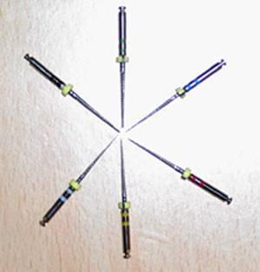
PROFILE
O . S .
.04 / 4% TAPER
LENGTH=19MM
.05/20
.06/30
.06/40
.07/50
.08/60
.08/80
LENGTH = 21/25/31MM
SIZE = 15-40/45-90
.06 / 6% TAPER
LENGTH = 21/25MM
SIZE = 15-40

Slide 24
PROFILE
Cross Section |  | Modified U- Blade
Radial Lands |  | Yes
Tip Type |  | Rounded
Rake Angle |  | Negative
RPM |  | 150-350

Slide 25
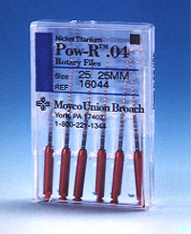
Pow-R System
Cross Section |  | triangular passive flute design
Radial Lands
Tip Type |  | Non-cutting “R” bullet tip
Rake Angle
RPM |  | 150 to 300

Slide 26
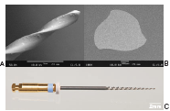
HERO 642
Cross Section |  | Triple Helix Three Edges
Radial Lands |  | No
Tip Type |  | Non-Cutting Passive
Rake Angle |  | Positive
RPM |  | 300-600

Slide 28
Additions to the FKG Race System
NiTi S-Apex
Breaking point designed at the junction og working end & shank

Slide 29
K3
Cross Section |  | Assymetrical three Edges
Radial Lands |  | Yes
Tip Type |  | Non-Cutting Safety Tip
Rake Angle |  | Positive
RPM |  | 300-350

Slide 30
Electropolishing results in distinct improvement of the surface composition and properties of NiTi instruments and produces a surface layer free of organic and inorganic contaminants.
Surface properties of nickel-titanium rotary Instruments ENDO 2007;1(1):45-52
Antonio Bonaccorso, Teresa Roberta Tripi, Giuseppe Cantatore, Guglielmo Guido Condorelli

Slide 31
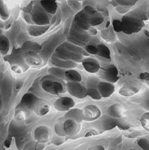
TAKE HOME MESSAGE
From a biological perspective, root canal treatment is directed toward the elimination of micro-organisms from the root canal system and the prevention of reinfection.
Technological advances in the form of rotary NiTi instruments have led to dramatic improvements in the ability to shape root canals with potentially fewer procedural complications.

Slide 32
QUESTIONS
What are GG burs?
Give standardization of rotary instruments?

Slide 33
REFERENCES
Endodontic Practice 11th Edn. Grossman
Pathways Of The Pulp 6th Edn. & 9th Edn. Cohen
Endodontics Vol 1 Arnaldo Castellucci
Endodontics Ingle 5th Edn.
Text book of Endodontology Bergenholtz Reitz
Endodontic Therapy Weine 5th Edition
Color atlas of Endodontics William Johnson
Principles and practice of Endodontics- Walton &Torabinejad
Color Atlas of Microsurgery in Endodontics Syngcuk Kim
Textbook of Endodontics Nisha Garg Amit Garg

Slide 34
THANKYOU

